Slide 1


Slide 2
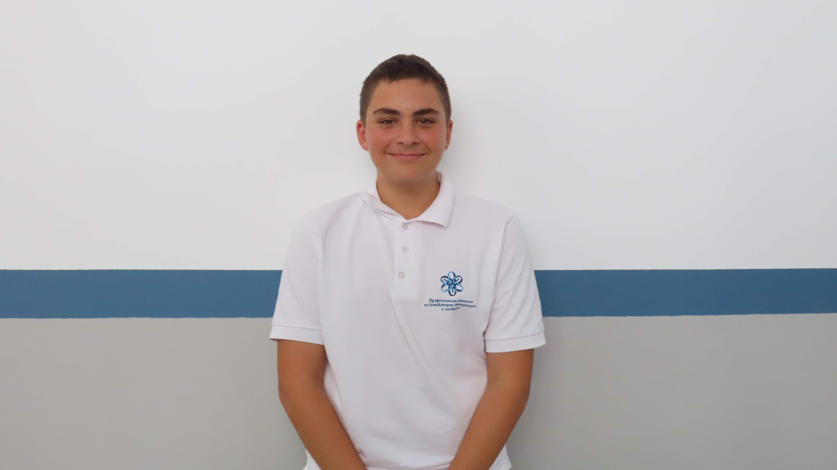
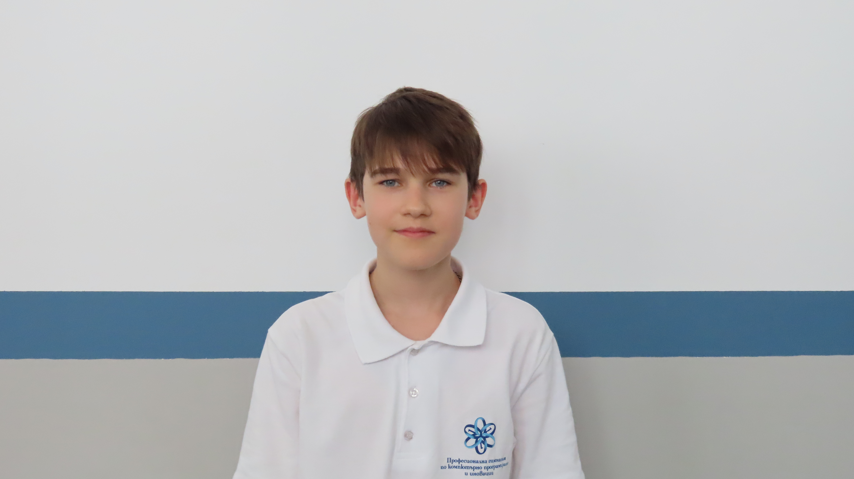
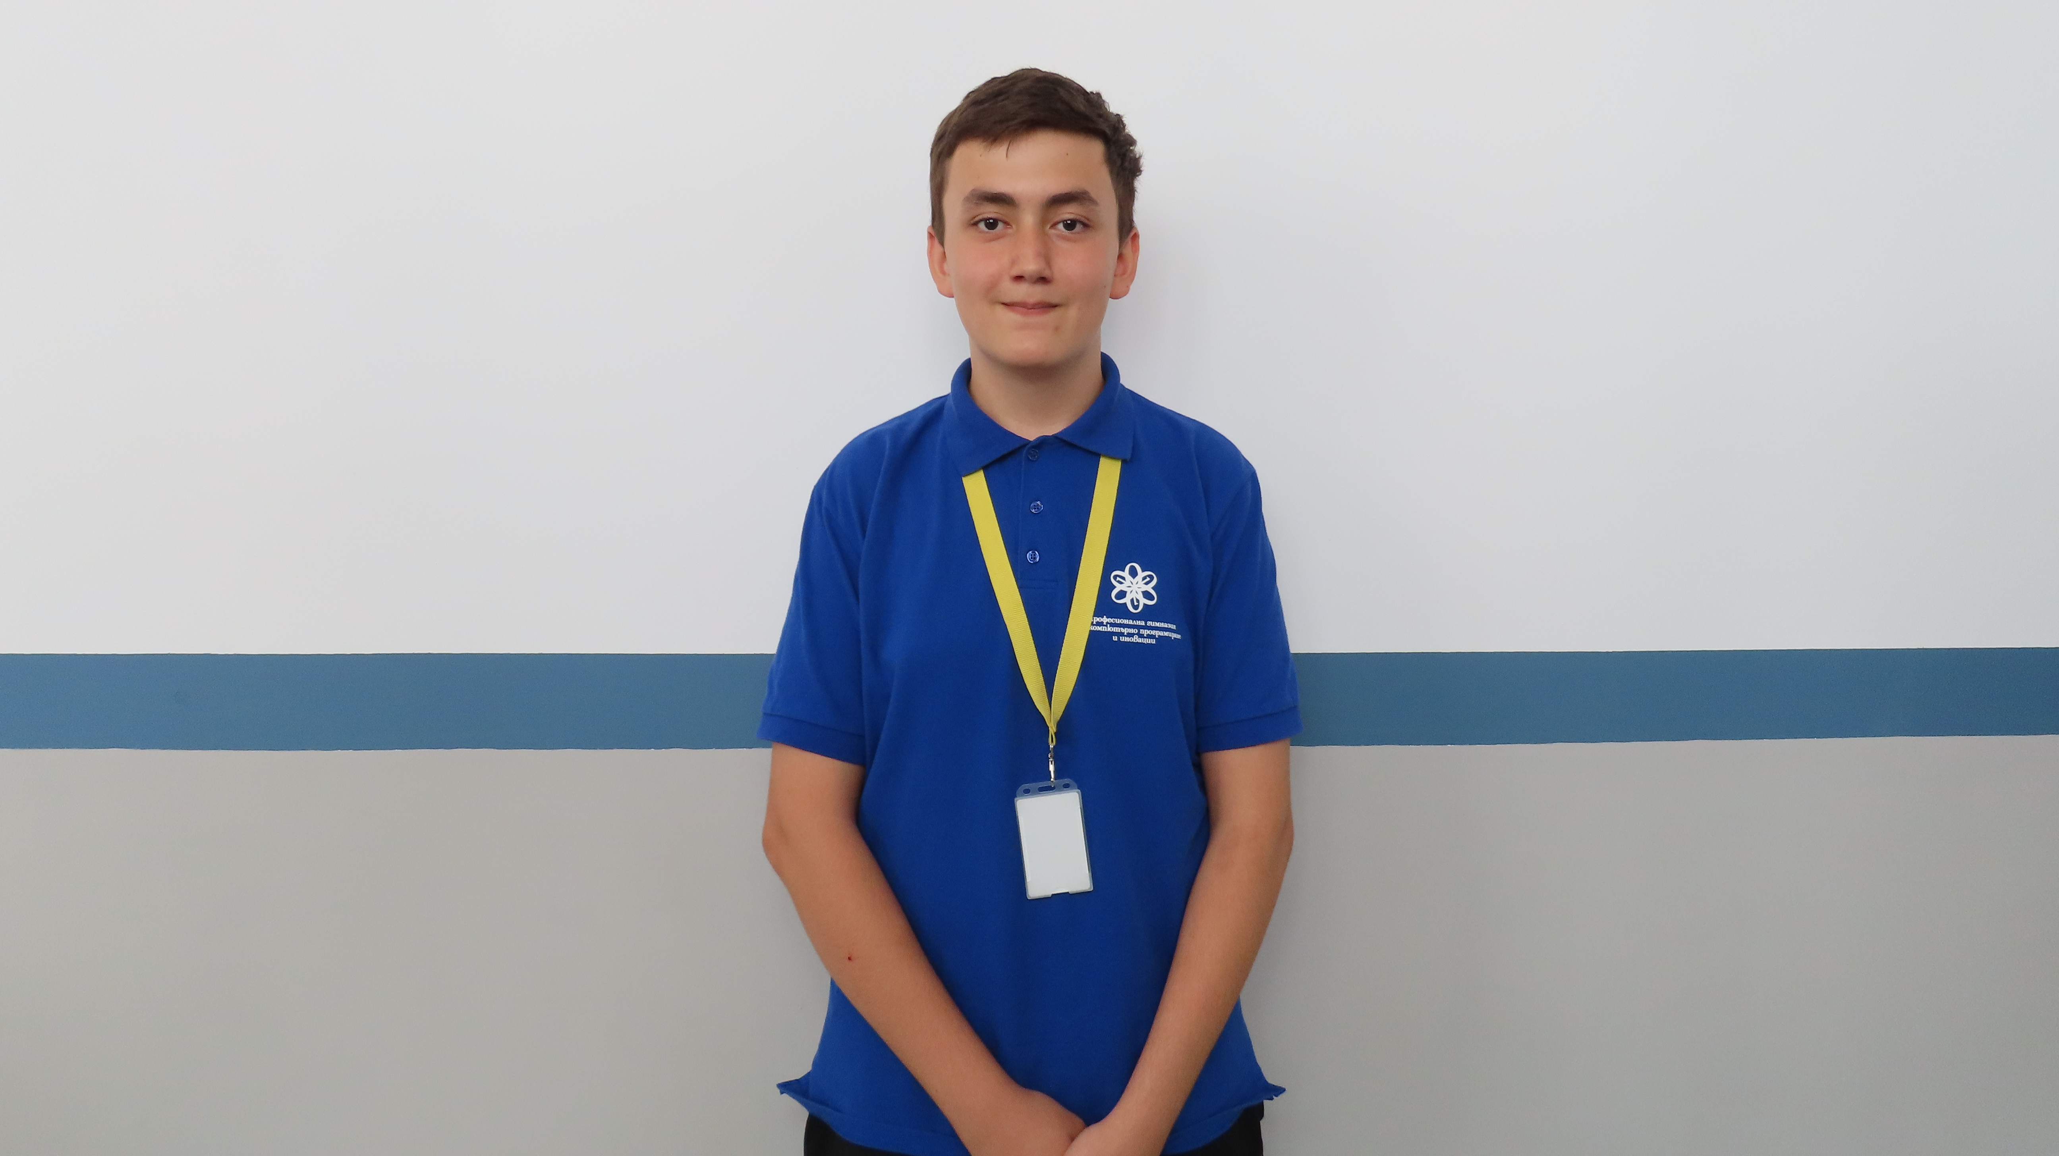
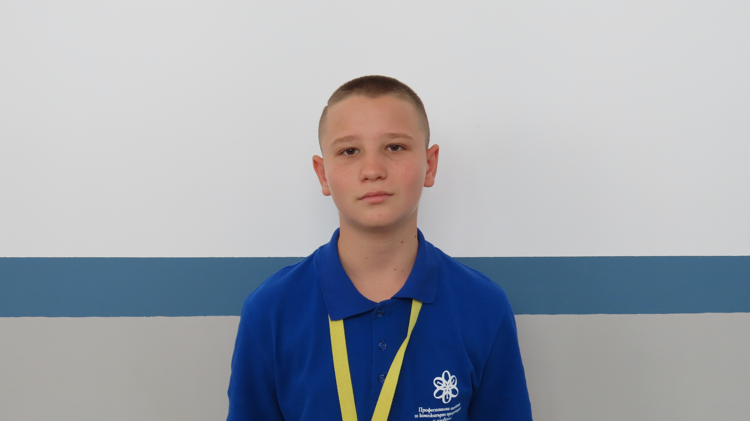
Team
Константин Турманов: Scrum Trainer
Кирил Жиличев: Back-End Developer
Давид Папазян: Back-End Developer
Георги Лицановски: Back-End Developer

Slide 3
Our idea
Our idea is to create four simple math games using the C++ programming language, aiming to develop something fun and engaging that also offers an opportunity to learn.

Slide 4


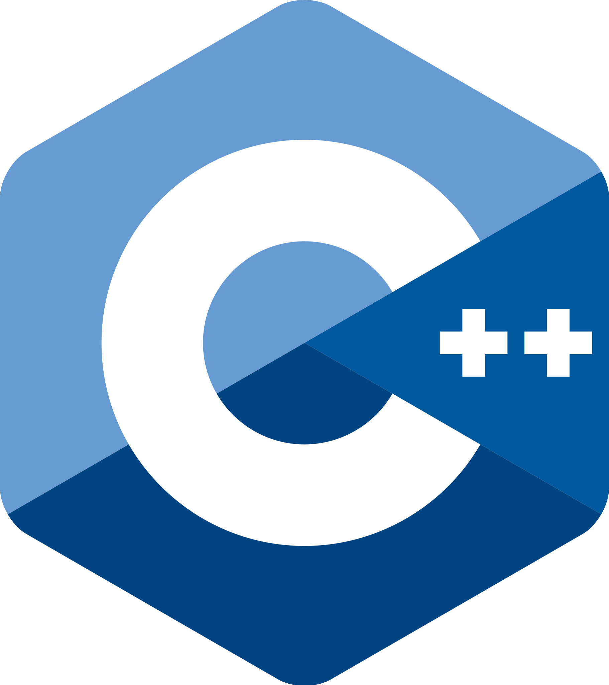



Technologies

Slide 5
Now let’s check out a quick demo

